Slide 1

Adaptive Graph-Based Algorithms for Conditional Anomaly Detection and Semi-Supervised Learning
Michal Valko
Computer Science Department University of Pittsburgh
Advisor: Milos Hauskrecht
Committee: Liz Marai, Diane Litman, John Lafferty (CMU)
University of Pittsburgh, August 1st, 2011

Slide 2


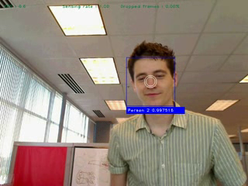
My Research
My research
Learning with minimal feedback
Online adaptation
Example: Online Face Recognition
Changing light conditions
Different backgrounds
Faces change
Outliers
Approach
Similarity graph as a representation
Data dependent, non-parametric
Notes:
Video only for the 2nd part
If we want people to enjoy the benefits of Artificial Intelligence,
We need to give then systems that they don’t need to train much
Before they can be useful. Morever,
Take for example a face recognition application. That is showing on the slide.
We don’t want to train it much so we will only provide one example of each person.
That is the challenging problem, especially when the light conditions backgroung change.
Or when people grow facial hair. It becomes even more challenging in the presence of outliers.
In this talk we will take advantage of using a similarity graph as the representation.
Similarity graphs help us model the relationship between the examples, such as images of faces.

Slide 3
Outline
Graph Based Learning
Semi-Supervised Learning (SSL) on Graphs
Online SSL with Quantized on Graphs
Application: Online Face Recognition
Conditional Anomaly Detection
Application: Medical Error Detection
Notes:
I will start with the introduction of graph based learning and semi-supervised learning.
After that I will talk about the contribution we made in the field of Online Semi-Supervised Learning.
As well as our theoretical results.
The I showcase the application on the online face recognition
After that I will extend the graph based inference to the conditional anomaly detection problems.
And show how it helps us to solve an important problem of error detection in medicine.

Slide 4











Graph Based Learning
Data adjacency graph W is a graph that represents the structure of data
The vertices of the graph are data points x_{i}
The edges of the graph are weighted by the similarity of the vertices:
Notes:
Graph Based Learning is widely used in Machine Learning
For problems like Clustering or Semisupervised Learning.
We describe graph learning inference on an example of the face recognition.
Say that we are given the images of the faces.
We will assign each image to the node in a graph.
Where edges represent the similarity
POMIESAT
Co robia grafy s datami
GRAF prepoji faces, similarity is defined from featurs

Slide 5
Graph Based Learning
Data adjacency graph W is a graph that represents the structure of data
The vertices of the graph are data points x_{i}
The edges of the graph are weighted by the similarity of the vertices:
Notes:
Such similarity graph can help us explore a structure In data.

Slide 6
Semi-Supervised Learning
Semi-supervised learning (SSL) is machine learning paradigm for learning from both labeled and unlabeled data
If a vertex x_{i} is labeled, its label is
Nick
1.0
Unlabeled data
-1.0
Sumeet
Notes:
SSL is ML paradigm for learning from both labeled.
This is a good way for us to come up with algorihms that
Require minimal feedback and training from us.
On the example on the slide only 2 of the faces are labeled
And we would like to infer the labels for the remaining ones.
SSL can take advantage of that and come up with a classfiers that take the unlabeled
Data into account.
In the following we assign number 1 the examples of one class
And -1 to the examples of the other.

Slide 7
Semi-Supervised Learning on Graphs
The structure of the graph W is used to infer labels of unlabeled data
Unlabeled examples can be labeled based on a random walk on the graph:
Nick
1.0
0.8
0.5
1.0
-0.1
1.0
-0.4
-1.0
1.0
-1.0
-0.7
Sumeet
Notes:
DEMO

Slide 8

Harmonic Function Solution
A standard approach to semi-supervised learning:
Rewritten in terms of the graph Laplacian L = D – W:
Properties of the harmonic function solution (HFS):
Smoothness
Closed-form solution
Can be interpreted as a product of a random walk on the graph W with the transition matrix

Slide 9
Harmonic Function Solution
Harmonic function solution is a result of a random walk on the graph W
Advantages:
Tracks non-linear patterns
Convexity
Globally optimal
Disadvantages:
Sensitive to the structure of the graph (problem-specific calibration is usually needed)
Nick
1.0
0.8
0.5
1.0
-0.1
1.0
-0.4
-1.0
1.0
-1.0
-0.7
Sumeet

Slide 10
Online HFS
Inputs: an example x_{t}, a similarity graph W
Algorithm:
Add the example x_{t} to the graph W
Compute the Laplacian L of W and infer labels:
Predict
Outputs: a prediction , an updated graph W
What is wrong with this algorithm?
Time complexity of θ(t)
Time complexity of Ω(t²)
Reduce the number of nodes
Semi-Supervised Perception: Real-Time Learning without Explicit Feedback. In Proceedings of the 4th IEEE Online Learning for Computer Vision Workshop, San Francisco, California, June 2010. Best paper award.
Notes:
Traditionally in SSL data are given appriori.
Now I assume that the data arrive in the stream and we want to
Make a prediction online.
Want to make a prediction.

Slide 11
Graph Quantization
Our solution combines
Online Clustering
Semi-Supervised Inference
Online clustering based on k-center clustering algorithm of Charikar et al. (1997) incrementally covers data by a set of R-balls
2
Nick
2
4
5
3
R
R
3
6
8
Sumeet
Online Semi-Supervised Learning on Quantized Graphs. In Proceedings of the 26th Conference on Uncertainty in Artificial Intelligence, Catalina Island, California, July 2010.
Notes:
THE IDEA IS TO USE THE SMALLER NUMBER OF EXAMPLES
My solution to the problem of growing graph for predicting the labels for streams of new examples
is to combine the 2 ideas.
Online clustering to reduce the number of nodes
And SLLL
Charikar’s algorithm comes with guaranties on the covering
Examples with a limited number of samples.
In my work I extended these guarantees to bound the approximation error of the Graph Laplacian.

Slide 12

Graph Quantization
When the example x_{t} is less than R away a representative vertex, the example is discarded
When the graph gets large
R is doubled
vertices are repartitioned
no two vertices are closer than R
old vertices are covered by at least one new vertex
2
Nick
2
5
4
5
3
R
R
3
6
8
Sumeet
Notes:
Sentences too long
Break into the parts

Slide 13
Graph Quantization
When the example x_{t} is less than R away a representative vertex, the example is discarded
When the graph gets large
R is doubled
vertices are repartitioned
no two vertices are closer than R
old vertices are covered by at least one new vertex
Nick
R
2R
2R
R
Sumeet
Notes:
Urobit movie
Pride face
Recluster
Drop the rest

Slide 14
Online Quantized HFS
Inputs: an example x_{t}, a similarity graph W of up to k representative vertices, a diagonal matrix of vertex multiplicities V
Algorithm:
Add the example x_{t} to the graph W and quantize it
Update the matrix of vertex multiplicities V
Compute the Laplacian L of (V W V) and infer labels:
Predict
Outputs: a prediction , an updated graph W and multiplicities V
Time complexity of θ(k)
Time complexity of O(k³)
Real-Time Learning without Explicit Feedback. In Proceedings of the 4th IEEE Online Learning for Computer Vision Workshop, San Francisco, California, June 2010. Best paper award.

Slide 15


Outliers
Real-world problems often involve outliers
Extrapolation to unlabeled data needs to be controlled
The graph W is turned into an ε-neighborhood graph
The HFS is regularized as:
If the label of an example x_{t} cannot be inferred with a sufficiently high confidence, the example is discarded
Nick
0.9
0.6
0.2
γ_{g}
1.0
γ_{g}
γ_{g}
γ_{g}
0
0.0
0.8
0.0
γ_{g}
-0.1
-1.0
0.7
-0.9
-0.5
Sumeet
Notes:
In the real world problem we need to consider outliers.
K-center algorithms optimizes worst case
My solution is to that to introduce an artificial node (a sink)
With value 0 and connect every other node to.
This will effectively drives all the values closer to zero
But more so with the outliyin nodes. Because for those
This sink may be the closest examples.
If we cannot infer the label of a new example with sufficiently large confidence.
We will discard it.

Slide 16
Theoretical Analysis
Prove a bound of the form:
Idea of the proof: The regularization parameter γ_{g} is set such that the error term vanishes as n increases
Error of our solution
Empirical risk on labeled vertices
Online Semi-Supervised Learning on Quantized Graphs. In Proceedings of the 26th Conference on Uncertainty in Artificial Intelligence, Catalina Island, California, July 2010.
Notes:
The

Slide 17
Theoretical Analysis
The error of our solution can be decomposed as:
Error of our solution
Offline learning error
Online learning error
Quantization error
Claim: When the regularization parameter is set as γ_{g} = Ω(n_{l}^{3/2}), the difference between the risks on labeled and all vertices decreases at the rate of O(n_{l}^{-1/2}) (with a high probability)
Semi-Supervised Learning with Max-Margin Graph Cuts. In Proceedings of the 13th International Conference on Artificial Intelligence and Statistics, Sardinia, Italy, May 2010.

Slide 18
Theoretical Analysis
The error of our solution can be decomposed as:
Error of our solution
Offline learning error
Online learning error
Quantization error
Claim: When the regularization parameter is set as γ_{g} = Ω(n^{1/4}), the average error between the offline and online HFS predictions decreases at the rate of O(n^{-1/2})
Online Semi-Supervised Learning on Quantized Graphs. In Proceedings of the 26th Conference on Uncertainty in Artificial Intelligence, Catalina Island, California, July 2010.

Slide 19
Theoretical Analysis
The error of our solution can be decomposed as:
Error of our solution
Offline learning error
Online learning error
Quantization error
Claim: When the regularization parameter is set as γ_{g} = Ω(n^{1/8}), and the Laplacians L^{q} and Lº and normalized, the average error between the online and online quantized HFS predictions decreases at the rate of O(n^{-1/2})
The distortion rate of online k-center clustering is O(k^{-1/d}), where d is dimension of the manifold and k is the number of representative vertices
Online Semi-Supervised Learning on Quantized Graphs. In Proceedings of the 26th Conference on Uncertainty in Artificial Intelligence, Catalina Island, California, July 2010.

Slide 20


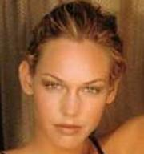


Experiment 1
One person moves among various indoor locations
4 labeled examples of a person in the cubicle
Labeled
Unlabeled
Unlabeled
Unlabeled
Unlabeled
Online HFS outperforms OSSB (even when the weak learners are chosen using future data)
Online HFS yields better results than a commercial solution at 20% of the computational cost
Notes:
TO test algorithm and it’s robustness to the outliers we used the following setup.
….
Podrobne popisat
4 labeles instances (dat na slide)
Target person moves among 8 different location
1000 Random unlabeled faces are injected in the stream
Uses hand craftet features specifically designed for face recognition

Slide 21
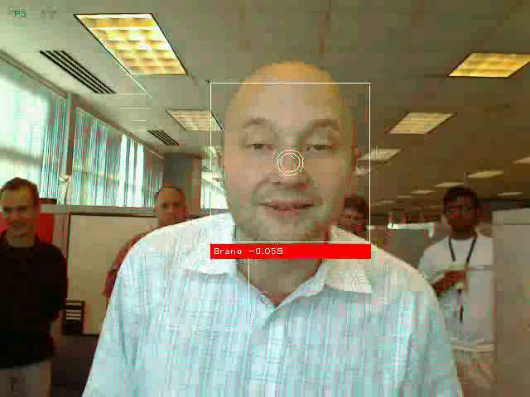
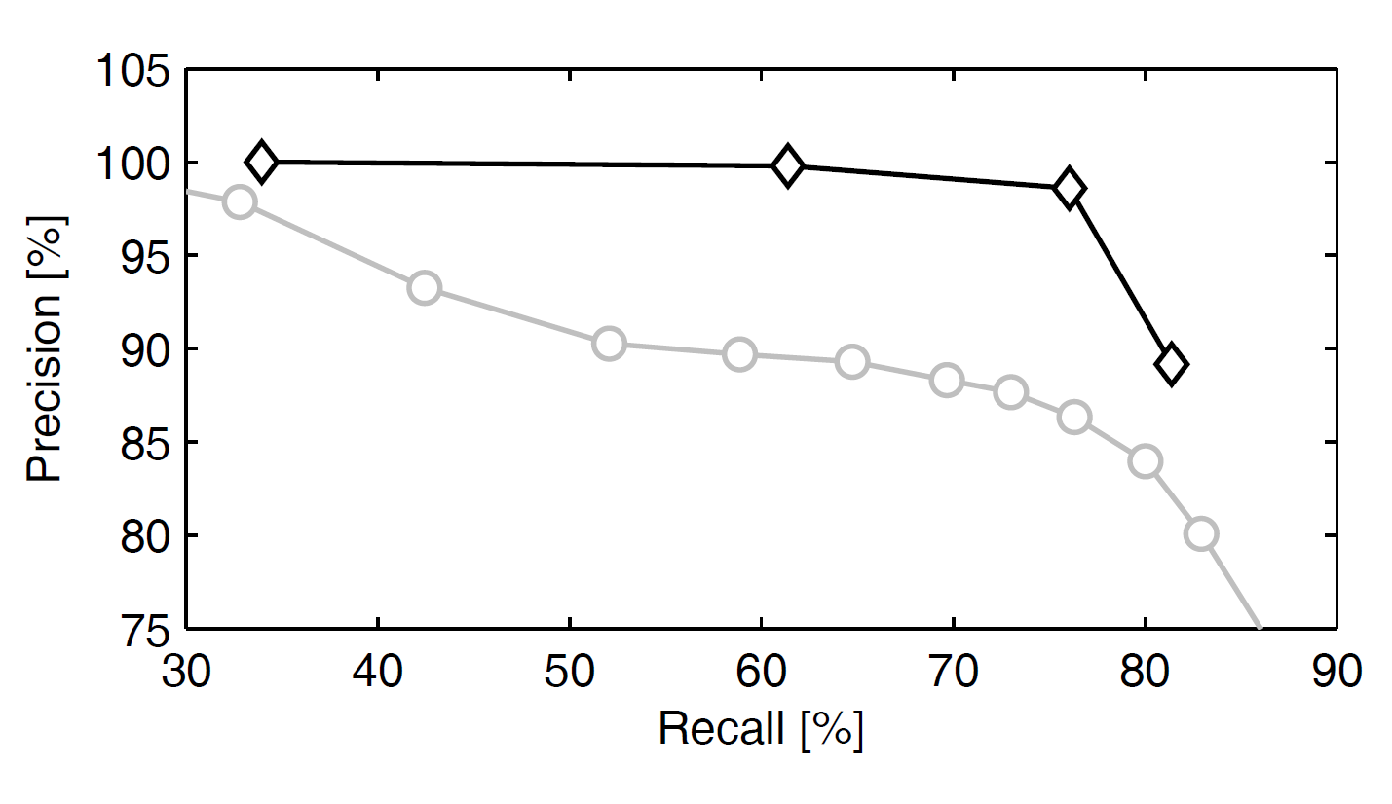
Mutli-class Experiment
8 people classification
Making funny faces
4 faces/person are labeled
Better
Our method
Nearest Neighbor
Notes:
Bolo tam 8 ludi, kazdy ma 4 labeled examples at the beging
Popisat co sa robi na movie
Pridat slide na comparison s NN

Slide 22
Parallel Harmonic Solution
Addressing scalability
Learning several smaller manifolds
Inference in parallel
Good approximation when the similarity matrix has a block-diagonal structure
Notes:
With just described algorithm, we made graph-based learning work for streams of the data.
However, the more nodes we store in the graph, the more complex data we can model.
As we said earlier, label propagation does not scale well beyond few thousand of nodes.
Therefore, we proposed the following approximation to speed up the inference.
We decompose one big graph into several smaller graphs and instead of
Tracking 1 manifold, we will be tracking several smaller ones.
And since the label propagation is about cubic, we will can achieve speedup that way.
The other benefit of such decomposition is that we can keep updating the smaller graphs in parallel, which can give us ideally additional speedup up to number of processors
In general, this decomposition would be a good approximation in the case that the similarity matrix has a block-diagonal structure.
In other words, the nodes in that are in different smaller graph, are indeed far from each other.

Slide 23





Parallel SSL Experiment
authentication with a face
logging into a tablet PC with their face
10 different locations
when the owner is not recognized
enters a password
we get a new labeled example
Notes:
We performed to evaluates this approximation of the experiment wit face-based authentication .
In this experiment the goal is to log in into a tablet PC with your face.
For each person we recorded the a short video in 10 different location.
In the case that the owner is not recognized, they enter a password and we get a new labeled example

Slide 24
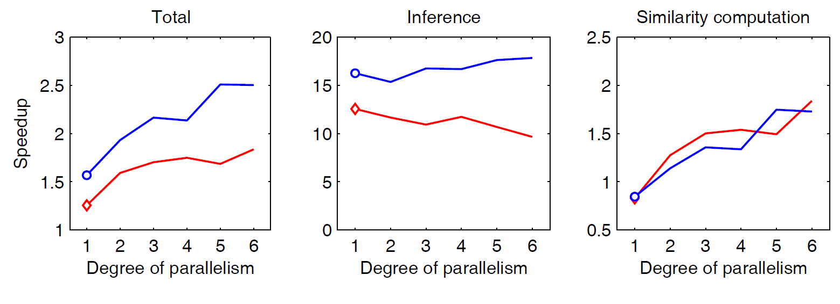
Parallel SSL Results
Nodes: 300 vs. 6x50
Speedup
35% due to decomposition
2x due to parallelism
Accuracy
Loss less than 3%
Person A
Person B
decomposition
Notes:
In the following graph we measure speedup as a function of number of processors.
The baseline is the inference on the full graph, it this case with 300 nodes.
First, we can see that we achieve speedup of around 35% for decomposing the graph to 6 smaller graphs, each with 50 nodes.
As we can see we can achieve additional about 2 fold speed up due to the parallelism.
We also looked where we are achieving the speed-up. We achieve more than 10 fold speedup in the inference, but that we don’t see the improvement when we increase the number o processors. The reason is that in the modern machines, solving SSE is already internally parallelized.
The overall speedup is then due to the computations of the similarity.

Slide 25
Outline
Graph Based Learning
Semi-Supervised Learning (SSL) on Graphs
Online SSL with Quantized on Graphs
Application: Face Recognition
Conditional Anomaly Detection
Application: Medical Error Detection
Notes:
In the remainder of the talk I will described an application of the graph based learing
To detect anomalies in the medicine.
I will focus on conditional anomalies.

Slide 26
Conditional Anomaly
Patient electronic records have: demographics, conditions, labs, medications administered, procedures performed,…
Notes:
Patient records today carry lot information about the patient.
And let me now draw your attention to the figure that shows where the drug for some patients should be ordered.
Every point either
+ means that the drug was ordered. – that it was not.
That’s what we call conditional anomaly.

Slide 27
Conditional Anomaly
Conditional Anomalies
Unconditional Anomalies
Assumption: Conditional anomalies correspond to medical errors
“Medical errors account for 200 000 preventable deaths a year. “
(HealthGrades study, Wall Street Journal, July 27th 2004)
Current systems use expert-created rules
Notes:
TRADITIONAL EXPERT DESIGNED RULE ARE CREATED
Our assumption is that many these anomalies correspond to errors, the deciosn
That physicians do about about the patient.
And it maybe very costly to do a error so it is very desirable to discover it and prevent it.
To goal is to reduce number of errors, which can improve medical care, save lifes and money.
Our contribution is in discovery of such anomalies.

Slide 28
Traditional Anomaly Detection
Nearest Neighbor
Distance – anomalies are distant (NN)
Density – anomalies in low density regions (LOF, COF, LOCI)
Classification
Model based (separate models for (ab)normal distributions)
1-class (1-class SVM)
Classify normal vs. abnormal (when labels available)
Statistical
> 3std
Notes:
Let us remind us the traditional AD. Methods in AD are very diverse and sometimes designed for a specific domain.
They that to rephrase the definition of anomaly to something that can be algorithmically searched for.
So for example NN method, look for that are either far from the others
Distance base method are using that fact that if I am further from my neighbors than they are from each other, I am probably anomaly
Density is about the thing that anomalies lie in low dens regions of the data.
For example, traditional statistical methods say that anything further that 3 standard deviation from the mean is an anomaly

Slide 29
CAD approaches
Class Outlier Approach
Discriminative Approach
Regularized Discriminative Approach
OneClass SVM, LOF, …
Soft Harmonic AD
SVM-CAD
Notes:
Zdoraznit my method
There are several ways how to approach the CAD problem for the anomalies in the class labels.
Remember for in this setting we consider we have all data full labeled and that goes for both the train data and the test data.
And the question we are asking is, is the label for the test cases anomalous? Or how much anomalous it is.
We will describe the three approaches to CAD and argue that the Regularized approach is the most appropriate.

Slide 30
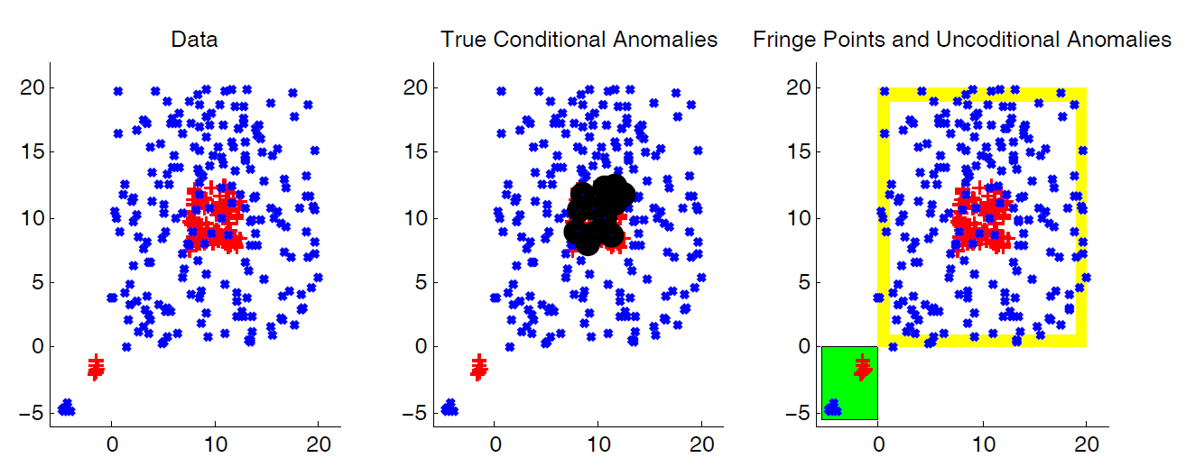
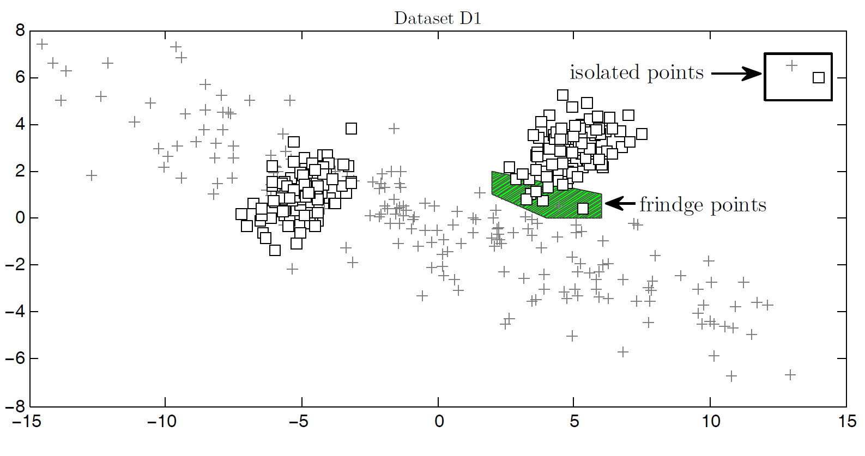
Challenges for CAD
Task: detect anomalies in labels/decisions
labels:
BLUE
RED
Dataset adopted from [Papadimitriou and Faloutsos, 2003]
Notes:
Again the topic of this work is Conditional Anomalies.
Since we are going to focus on anomalies in label, let me show an example of those.
But what we don’t want to be bothered with.?
First, the unconditional outliers. For those we really don’t know what the label should be.
In a hospital setting, imagine patient with a unprecedented symptoms. What ever treatment he will received, we don’t want to alert on it.
The second issue that the methods face is the issue of Fringe Points.
Fringe points are data lies at the boundary of the distribution support.
Both of those thing are the challenges for CAD

Slide 31
Class Outlier Approach
Take a test case (x,y)
Take any unconditional anomaly method
Find out if x anomalous wrt { x | x has class y }
ignores the other class(es)
Notes:
The first one is Class-Outlier approach.
This one is very easy to implement.
We take and off-the-shelf traditional outlier method and the case we want to check for being anomalous.
Look at the label. And using that method, we find out if that point is anomalous with the respect to the points with the same label.
Now, is this addressing out challenges.
Fringe points will be a big issue for a such a method, esp when the sample size is small.
Unconditional outliers would be the other: While this approach can detect if the point is far from points of its own class, it does not now if it is placed among the points from a different class, or it is just completely isolated.
The main reason why these method may not work the best, is that they ignore the other classes, which is important.
One other problem could be that the anomaly scores we get for the data points with the same label may not be comparable.

Slide 32
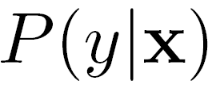
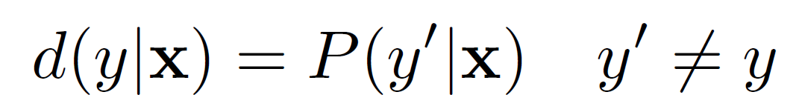
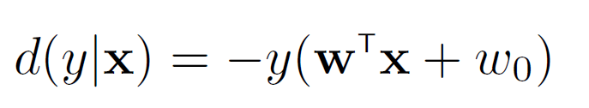
Discriminative Approach
is small → conditional anomaly
Learn Model/Build Projections
Bayes Network
bigger the alert score→ more anomalous
Support Vector Machines projections
1
2
19
3
18
4
5…16
17
score
boundary
margin
Notes:
So we know, we want to be aware of other classes.
In we have a probabilistic model for our data. Then we can say if the conditional probability of the label is small, then we have a conditional anomaly.
And the do not necessarily need a probability model, we can just use a projection.
First we can use a Bayesian Network that represent stochastic relations between the description and decision variables.
(One option is to use fixed structure, such as Naïve Bayes displayed on the slide, for which we can learn parameters from the data. )
Anomaly projection in this case is then posterior probability of the physician decision
Another way how we calculated the anomaly projection d was using SVM projections.

Slide 33
Discriminative Approach
Problem: (unconditional) anomalies
Can become overly confident in the low density areas
Notes:
The first one is Class-Outlier approach.
This one is very easy to implement.
We take and off-the-shelf traditional outlier method and the case we want to check for being anomalous.
Look at the label. And using that method, we find out if that point is anomalous with the respect to the points with the same label.
Now, is this addressing out challenges.
Fringe points will be a big issue for a such a method, esp when the sample size is small.
Unconditional outliers would be the other: While this approach can detect if the point is far from points of its own class, it does not now if it is placed among the points from a different class, or it is just completely isolated.
The main reason why these method may not work the best, is that they ignore the other classes, which is important.
One other problem could be that the anomaly scores we get for the data points with the same label may not be comparable.

Slide 34
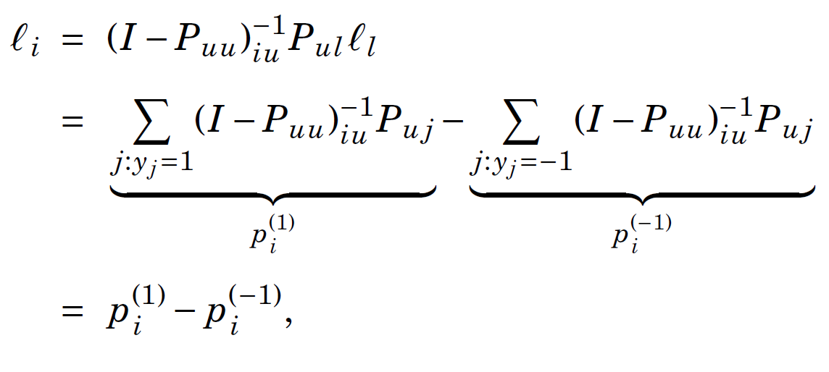

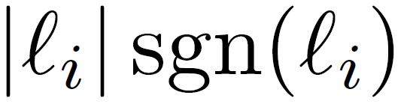



Regularized HS for CAD
-0.9
0.9
-1.0
=
x
when is rewritten as
can be interpreted as a confidence
>> 0.5 and
regularization (with sink) diminishes the effect of outliers
Conditional Anomaly!
Notes:
The reason why I shown this formal definitions is that we can rewrite inferred labeled as
A differencen between probability of a positive and negative label.
The other observation we are going to make is that inferred label ranging from -1 to 1 can,
Rewritten as the absolute value times sign.
While sign can be interpreted as the inferred label.
Absolute value can be interpreted as a confidence
The reason we rewrote this that way is that when the confidence of the inferred label is high and
The inferred label is different that the actual label, we have an conditional anomaly!
And the confidence can directly serve as an anomaly score.

Slide 35
Synthetic Data
evaluation of conditional anomaly methods is challenging
synthetic data with known distribution
flip 3% of the labels
compare how the anomaly score agrees with true score

Slide 36
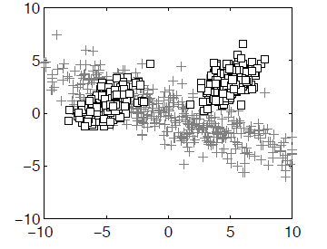
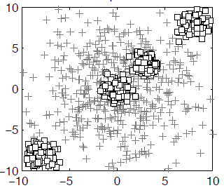
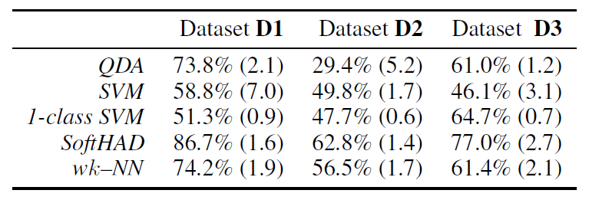
Synthetic Data: Results
Evaluation metric:
How the anomaly score agrees with the true score
BETTER

Slide 37
Top 5 best scoring anomalies for different methods on the synthetic dataset D3
TRUE
OUR METHOD
Notes:
describe

Slide 38
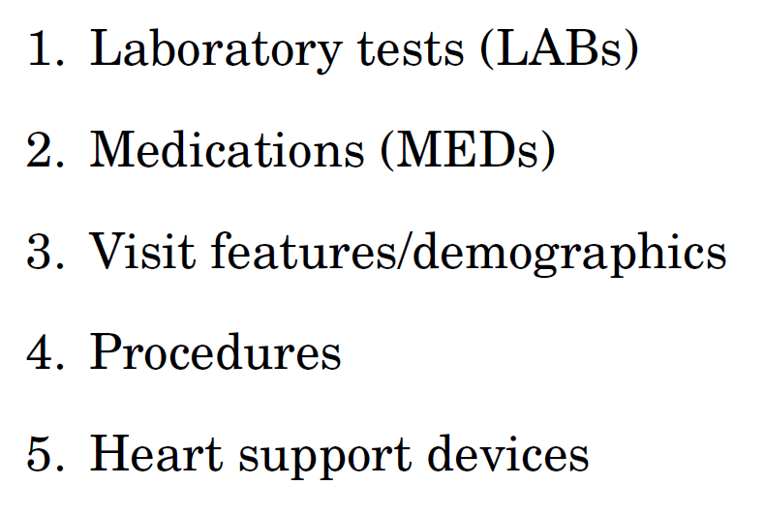
Medical Data
4486 patients from UPMC
Cardiac surgery (2002-2007)
45767 patient-day events/states
9K attributes
222 states evaluated by 15 experts
Metric: How much the score agrees with the experts.
Notes:
After a one smaller study on pneumonia dataset, which is described in the document, And experiments on the artificial datasets
We evaluated just mention SVM anomaly detection we did a pilot study on the cardiac surgery patients.
The main purpose of this study was to test if we can indeed detect clinically useful alerts.
We had 4 thousand cases, which stay about 10 days in a hospital on average.
Which comes to about 40 thousand patient days.
9 thousand featers.
Of these we selected 222 cases to be evaluated by the panel of 15 experts, where each case was reviewed by 3 experts.
EMR consisted of the following 5 different sources shown on the slide.
I am not going go into details of each of those, but I will show how did we get feature from DB.

Slide 39
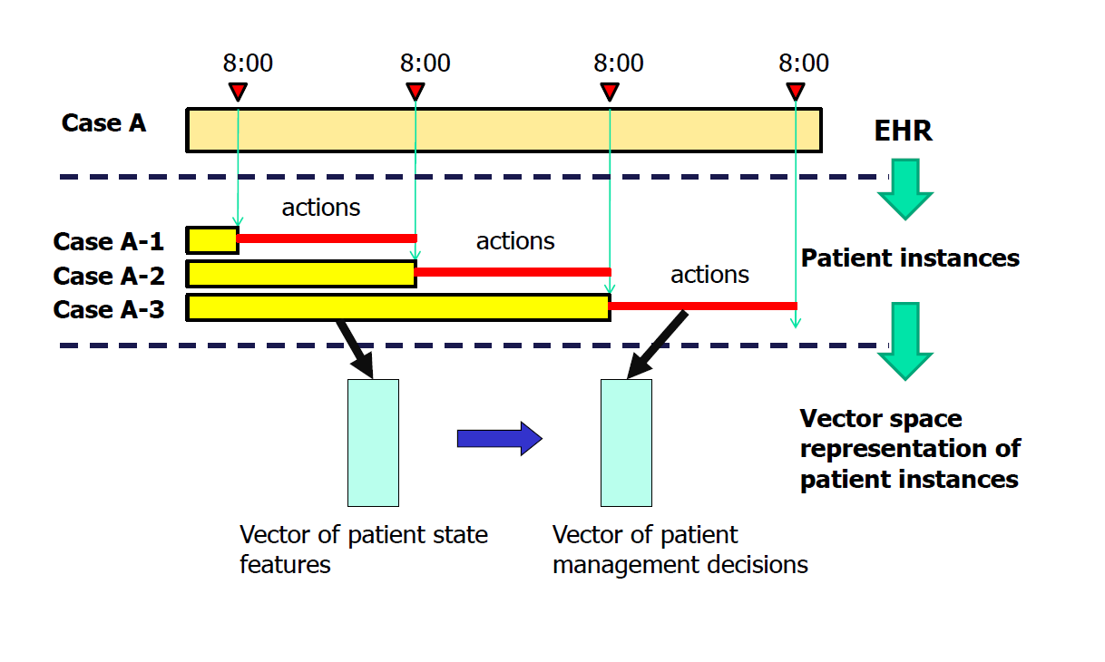
PCP data set: Segmentation
Notes:
This picture shows one patient during their stay for about 4 days.
Each day at 8am, we captured their state.
For each state we summarized it’s history until that time points in about 9K features.
And recorded what decision occurred in next 24 hours.
Decision were of the 2 kinds:
order a lab or not.
order a medication or not
And we were interested if we can detect anomalies in those decisions.

Slide 40
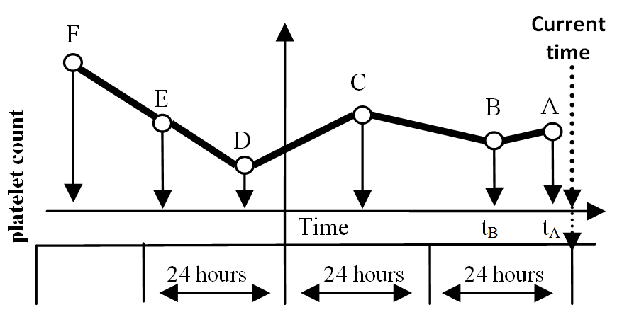
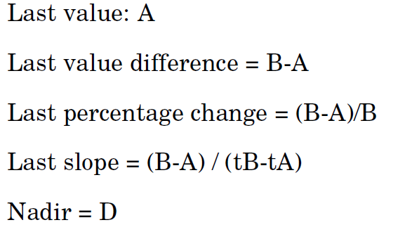
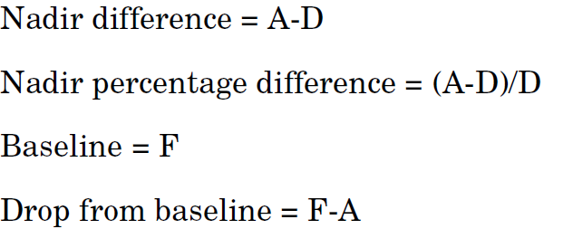
PCP Dataset: PLT Lab feature
Notes:
In this picture I am showing the how we constructed the feature. Say there were 6 labs of platelet count performed.
And example of the features we constructed from it.

Slide 41
Medical Data Results
Outperforming SVM-based method over the range of settings for regularization parameters
BETTER

Slide 42


Summary
Graph-based methods
Learning with minimal feedback
Semi-supervised learning
Online Learning with Quantization
Online Semi-Supervised Perception [CVPR – OLCV 2010]
Bounds on quality of the solution [UAI 2010]
Max-Margin Graph Cuts [AISTATS 2010] (in the document)
Parallel Semi-Supervised Learning
Joint Quantization and Label Propagation (in the document)
Conditional Anomaly Detection
Discriminative Approach [ICML - HEALTH 2008, AMIA 2010]
Soft harmonic Anomaly Detection [ICML - GLOBAL 2011]
Detecting Unusual Medical Decisions
Evaluation on challenging real-world problems
Health Care Costs
Dr. Reinhardt NYT 12/19/2011
Notes:
TO sum up,
In this talk I went over methods that take advandtage of the graph based learning.
To come up with the algorithms that require minimal feedback
The presented contributions were in the 2 fields
SSL, and specini Online semi-supervised learning
Conditional Anomaly Detecction
With imp
Sustredit sa na hlavne myslienky
Big picture, vysvetlit princip.
Minimal feedback je tu vagne
(eliminated detailed)

Slide 43
Future Work
Scalability
Lifetime online learning
“Information exchange” between the manifolds
Concept Drift
Incremental clustering with forgetting the history
Recent data more important
Structured Conditional Anomaly Detection
drugs with the same effect do not tend to be given at the same time
drugs with the opposite effect do not tend to be given at the same time
drugs with negative interactions do not tend to be given at the same time
Distance Metric Learning for Temporal Data
Compare patient states at current time
Different kinds, number and time of measurements
Missing values
Free text
Notes:
Within these areas there are several future directions
Life-time learning.
Scalability
Concept drift
Online with forgetting
We plan to evaluate our approach for the online Anomaly detection task.
We plan to quantization for multiple classes, we probably don’t want to quantize positives and negative
but how many representative vertices we want to reserve for positive and negative vertices.
We plan to further analyze anomaly detection.
Perform another evaluation with the human experts.
Do more adaptive incremental clustering.
And make use of parallelization

Slide 44
Acknowledgements:
Milos Hauskrecht (PhD advisor), Branislav Kveton (Technicolor Stanford), Greg Cooper, Hamed Valizadegan, Ling Huang (Intel Labs Berkeley), Shyam Visweswaran, Daniel Ting (UC Berkeley), Lily Mummert (Google), Matthai Philipose (Intel Labs Seattle), Ali Rahimi (Intel Labs Berkeley), Saeed Amizadeh, Tomas Singliar (Boeing Research), Amy Seybert, Gilles Clermont, Rich Pelikan, Iyad Batal, Shuguang Wang, Quang Nguyen, Dave Krebs
NIH R21 LM009102–01A1, NIH 1R01LM010019-01A1, Mellon Foundation
Thank you!

